Slide 1
205 Jan 22, Class 9
Chapter 8, Research Ethics
  Fair and equitable treatment of human research participants
Gino & Wiltermuth (2014)
  Evil Genius

Slide 2
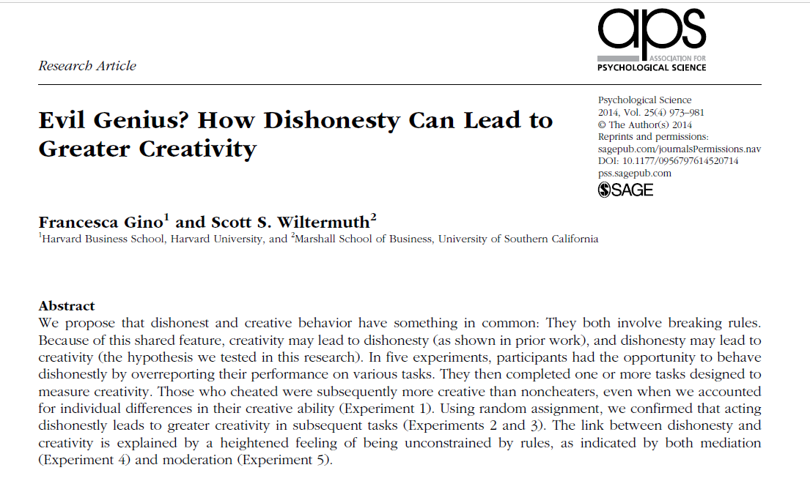

Slide 3
Operational definitions
Creativity
  Remote Associates Test (RAT)
  What is the common word that links
    Sore, Shoulder, Sweat
    Opera, Hand, Dish
    Piece, Mind, Dating
Dishonesty
  Experimentally controllable (or measurable) cheating or lying

Slide 4
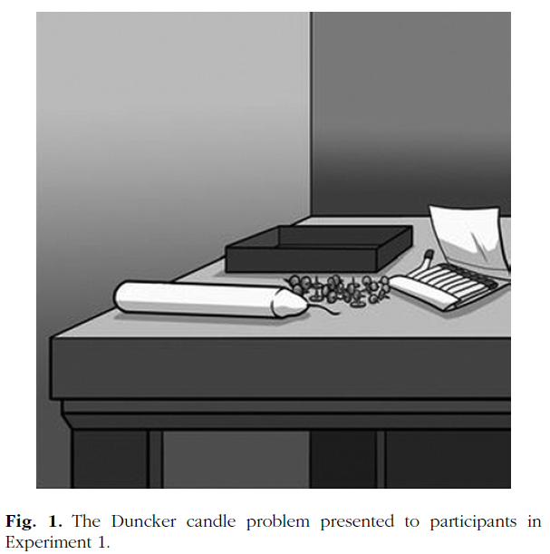
Experiment 1
Procedure
  Dunker candle problem
  Filler/cheatable task
    10 matrices
    Self-reported performance, paid
  RAT performance
Results
  Cheaters performed better on the RAT test

Slide 5
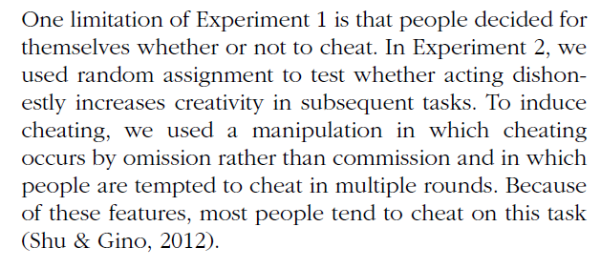
Experiment 2
How do you experimentally control cheating to be able to randomly assign participants to the “cheating” and control conditions?
  Operational definition of this IV

Slide 6
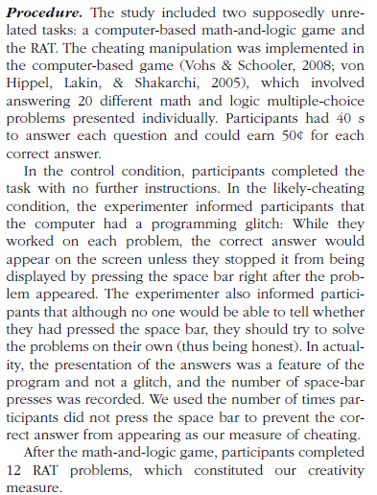
IV
DV

Slide 7
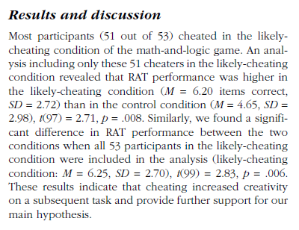
Effect size:
  6.20 vs 4.65 problems solved
  = 1.55 more
2 independent samples t-test

Slide 8
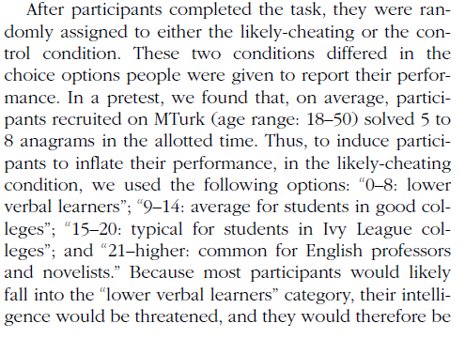
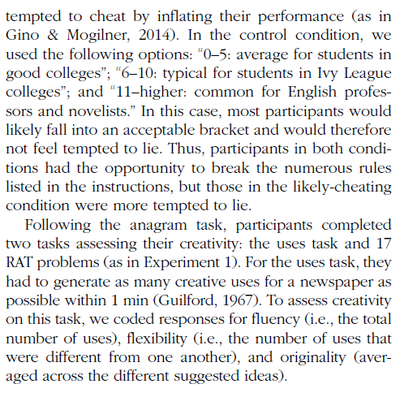
Gino & Wiltermuth (2014)
In Experiment 3, what is the IV changed to and why? How is the DV changed and why? What ethical issue in experimental research is now relevant?

Slide 9
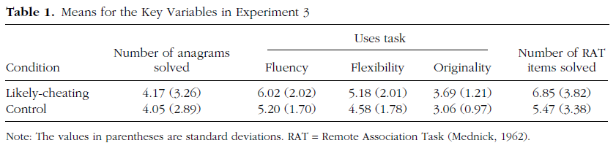
Exp 3 Results
Alternate hypothesis for Exp 3?
Ethical questions about this research?

Slide 10
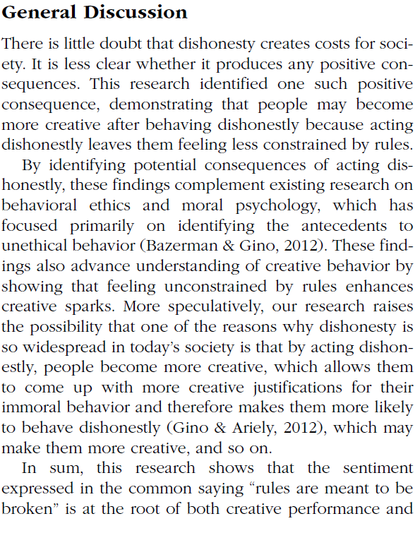

Conclusions
Experiments 4 and 5 use yet additional novel manipulations of honesty to measure creativity effects. From the General Discussion, how do the authors explain the overall set of their findings with respect to the theoretical relationship between dishonesty and creativity via a mechanism? Give an example of a speculative point made that goes beyond the statement of results.

Slide 11
Chapter 8
Research Ethics
  Fair and respectful treatment of participants in research
Basic Ethical Principles (Belmont Report)
  Respect for Persons
    Consent is voluntary
    Vulnerable populations are protected
  Beneficence
    Good outweighs the risk
  Justice
    Fairness in distribution

Slide 12
Famous ethical transgressions
Tuskegee Syphilis Study
Guatemala Syphilis
Willowbrook State School Hepatitis studies
Milgram studies
Zimbardo prison studies

Slide 13
Historical Events in Research Ethics
Nuremberg Code, 1947
  Response to Nazi researchers
Declaration of Helsinki, 1964
  Broader statement of principles
Belmont Report, 1979
  Respect for persons
  Beneficence
  Justice
APA Code of Ethics
  Includes integrity

Slide 14
IRB
What is the main goal and purpose of the Institutional Review Board?

Slide 15
Informed Consent
Before participating in a research experiment, all participants should generally read and sign an informed consent form. What are 3 main goals of this process intended to maintain ethical standards for the scientific work?

Slide 16
Ethical scientific practice
Assure fair treatment of participants
Institutional Review Board (IRB)
  Reviews all formal research
  Risk/benefit analysis
Informed Consent
  Right to withdraw
  Full disclosure: risks, benefits, procedure
  Privacy

Slide 17
Common risks in psychological science
Deception
  Lying to participants about the experiment
    Sneaky dependent variables
  Sometimes necessary for good design
Privacy
  Protecting identification of participants
  Which condition, whether you were in the study
Frustration/fatigue
Emotional manipulation

Slide 18
In a study of attitudes about extramarital affairs, a researcher finds that an acquaintance has participated in the study and reports having cheated on their spouse. They then find themselves torn about whether to report this information to the spouse. What kind of research ethics problem has occurred here? What research procedures should be used to keep this from occurring?

Slide 19
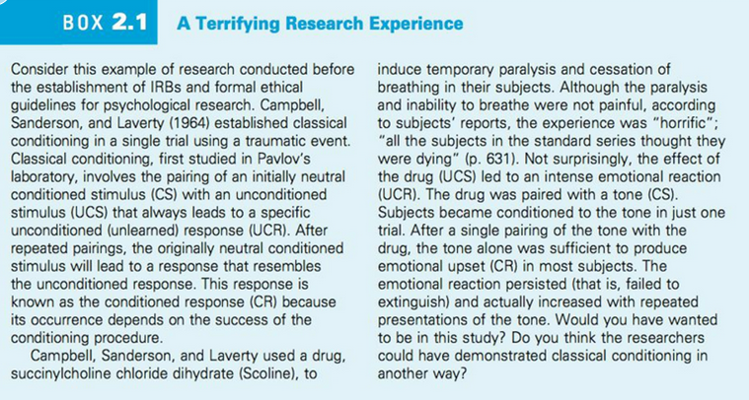

Slide 20
For Wed Jan 24
Exam 1
  Covers Chapters 1-8
  Prior exams posted to see format
    Note that specific topics covered were different in prior quarters
    Different tools/programs used for statistics
    You should be familiar with the output from R
Friday Jan 26 will be Chapter 9, Factorial design
  Then on to Experiment 2

Slide 21
Research definition
  “A systematic investigation, including development, testing, and evaluation, designed to develop or contribute to generalizable knowledge”
    Not including: case studies, biography or oral history research, classroom activities, publicly available data

